Slide 1
thermoregulation
Year 11 Biology
Bremer SHS

Slide 2
Warm up Questions
Outline the function of an enzyme.
Explain how temperature affects enzyme activity.
Define the term homeostasis.
How does the human body regulate temperature.
(Hint: how does your body react when it is too hot or too cold)

Slide 3
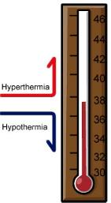
Temperature control
Different animals have slightly different internal temperatures at which their enzymes work most efficiently.
An endotherm controls its internal temperature using metabolic activity and an ectotherm uses the external environment.
The process of maintaining a stable internal temperature is known as thermoregulation.
Under extreme conditions (hypothermia or hyperthermia), the human body’s temperature control systems are unable to cope and could have potentially fatal consequences.

Slide 4
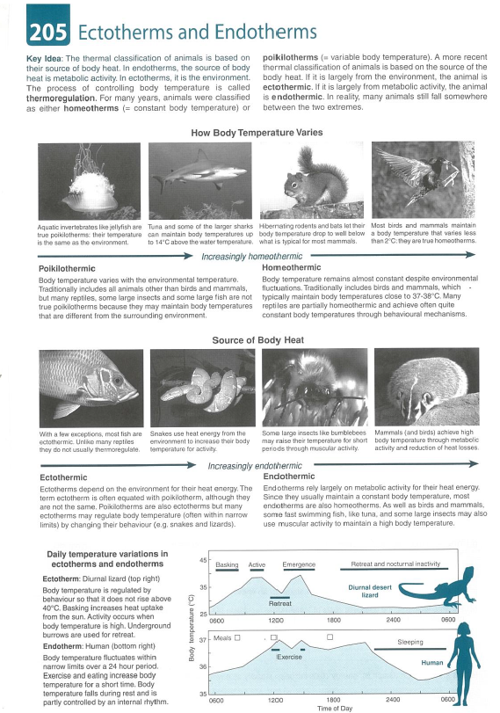
Check for understanding
Biozone 205 – Endotherms and Ectotherms

Slide 5
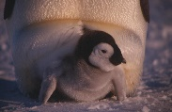
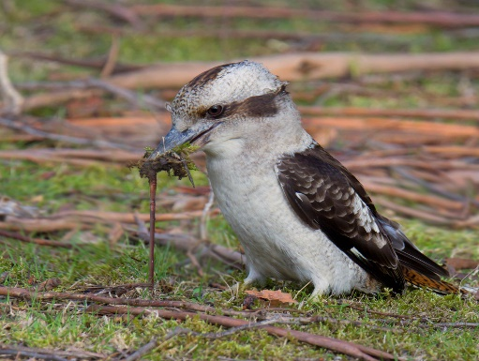
Structural adaptations for thermoregulation
Insulation
In cool environments, feathers and fur trap an insulating layer of warm air close to the skin.
In warm environments, fur can insulate from radiant heat.
Brown adipose tissue
Layers of brown fat under the skin insulate and help generate metabolic heat in cold climates.
Shape and size
Adaptations reduce or increase the surface area to volume ratio.
The several layers of scale like feathers of Penguins do not get ruffled by strong winds.
Some bird species in Tasmania are larger than mainland birds in order to retain more heat in a cooler climate.

Slide 6
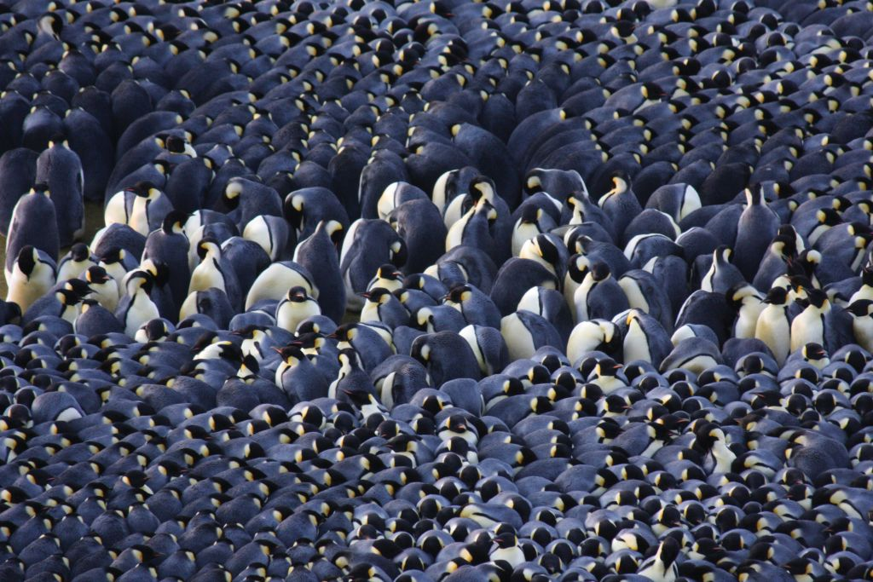
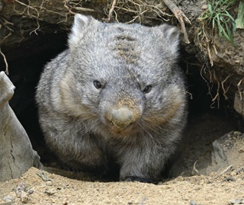
Behavioural adaptations for thermoregulation
Kleptothermy
One animal shares its warmth with another.
Torpor
Slowing of metabolic processes and reducing body temperature for a small period of time.
Hibernation
Reducing metabolic rate to a level that is only just able to support life.
Penguins huddle for warmth.
Wombats seek shelter in burrows during the warmest parts of the day.

Slide 7
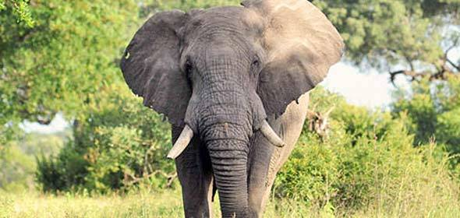
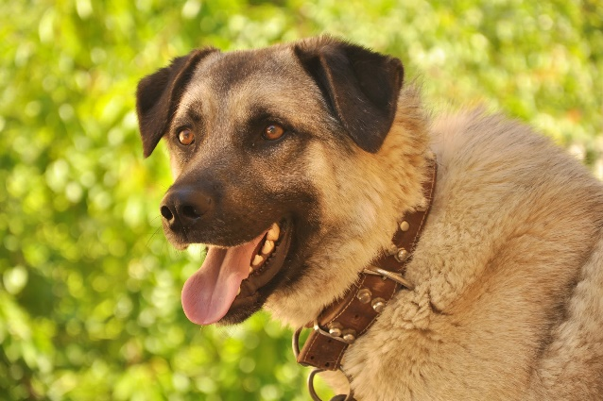
Physiological adaptations for thermoregulation
Vasomotor Control
Vasodilation allows increased blood flow near the surface of the skin, allowing heat to escape.
Vasoconstriction limits blood flow near the surface of the skin, limiting heat loss.
Evaporative Heat Loss
Evaporation of water from the skin cools blood in capillaries near the surface of the skin.
Panting increases evaporative water loss from the respiratory tract, cooling blood near the nasal cavity, mouth and tongue.
Thermogenesis
Rhythmic tremors caused by skeletal muscle contraction can increase heat production by several times.
The ears of elephants are lined with capillaries allowing heat loss through blood flow near the surface of the skin.
Dogs only produce sweat on areas not covered with fur, they must pant to increase evaporative heat loss.

Slide 8
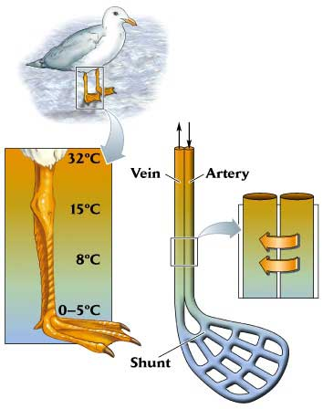
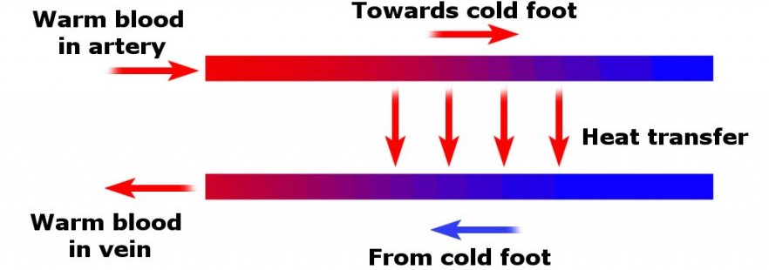
Physiological adaptations for thermoregulation
Counter Current Heat Exchange
Aquatic birds and mammals keep extremities warm by exchanging heat between arteries and veins that are in close contact with one another
Warm outgoing blood in the arteries is cooled by blood coming back from extremities.

Slide 9
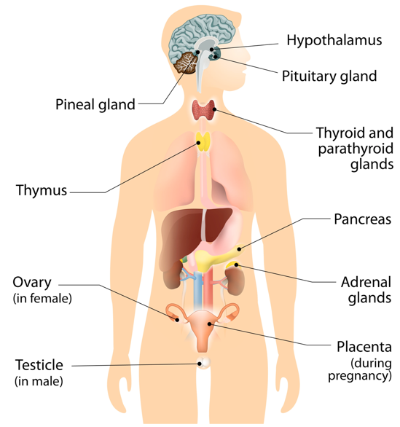
Homeostatic adaptations for thermoregulation
Negative Feedback
The hypothalamus is sensitive to the temperature of blood flowing through it and initiates appropriate responses to restore body temperature.
At low temperatures, thyrotropin-releasing hormone (TRH) is secreted by the hypothalamus, which activates the anterior pituitary gland to release thyroid-stimulating hormone (TSH). TSH stimulates the thyroid gland to secrete thyroxine which increases metabolic rate, increasing heat production.
When temperatures increase again, TRH secretion is reduced.

Slide 10
Adipose tissue
Mammalian adipose tissue is traditionally categorized into white and brown relating to their function and morphology: while white serves as an energy storage, brown adipose tissue acts as the heat generator maintaining the core body temperature.

Slide 11
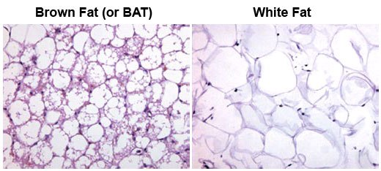

Slide 12
Brown adipose tissue
Brown adipose tissue is primarily found in newborns. It is characterized by many mitochondria (cell’s energy production site). The numerous mitochondria within these fat cells provides the brown colour of this type of fat cell. The function of this fat cell is to generate heat. It is primarily found in infants because infants do not have the ability to shiver when they become cold. Therefore, this type of fat tissue serves as a protective mechanism against cold temperatures when we are at our youngest.

Slide 13
White adipose tissue
White adipose tissue is the most common type of fat cell. It serves as the site for lipid storage. The more WAT a person has the slower their overall metabolism will be. This is one of the reasons why weight loss that targets WAT helps to increase or speed up the metabolism. These white fat cells are formed throughout life. These fat cells are also biologically active and secrete over 400 hormones, cytokines, and adipokines which serve to regulate the metabolism of the body.

Slide 14
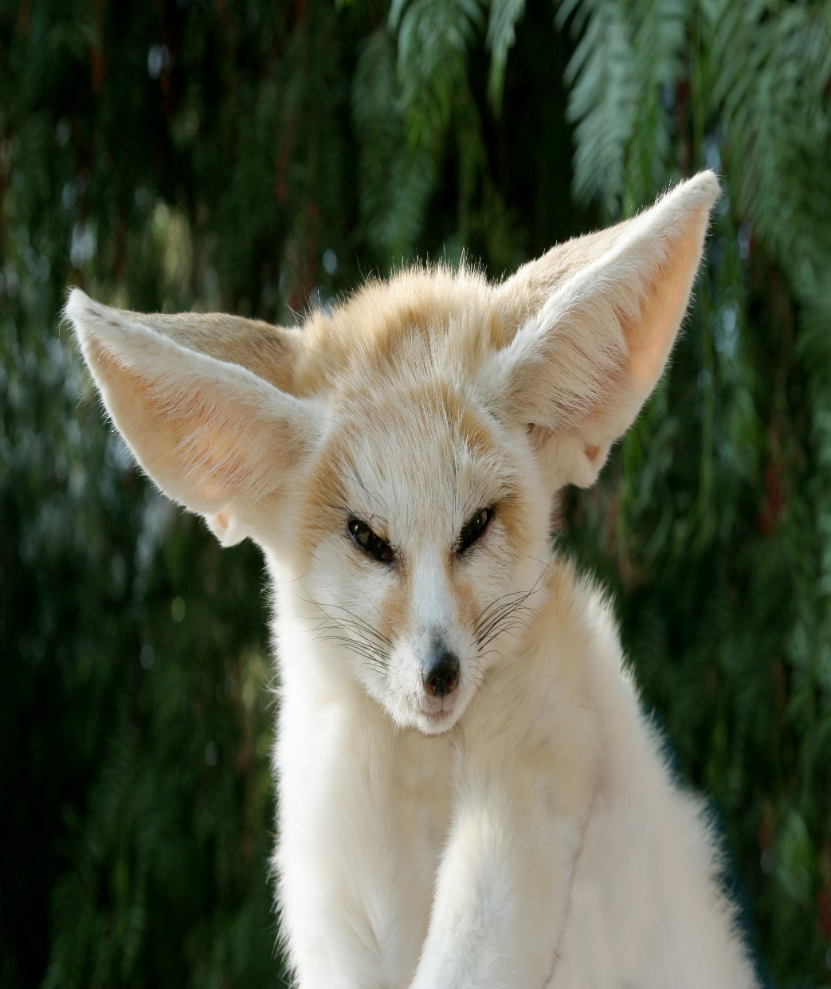
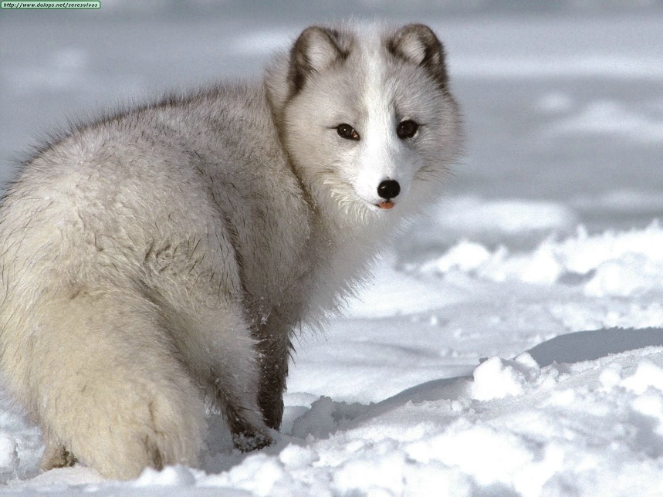
Fennec fox Arctic fox

Slide 15
shape and size difference between different species of fox
The primary differences between the Arctic and Fennec foxes stem from their respective habitats. The ears of the Arctic Fox are small to help the animal conserve body heat in its cold environment, and the overall build of the Arctic fox is stockier and more compact. Arctic foxes likewise have very thick fur. This body layout helps the animal conserve body heat and energy in the most efficient manner for its habitat. Meanwhile, the Fennec fox is slim and petite; this is an adaptation for the desert environment, where water is scarce. The fennec's fur is nowhere near as thick as that of the Arctic fox, but it is still enough to keep the animal warm on desert nights--which can get very cold.

Slide 16
Fur on paws in fox
An interesting trait shared by both Arctic and Fennec foxes is that they have fur on the undersides of their paws. The fur on the bottom of the Arctic Fox's paws help protect the animal from frostbite by providing an insulated layer between the cold snow and the animal's paw pads. The fur on the bottom of the fennec's paws, on the other hand, protects the animal from burning itself on the hot sand of its desert home.

Slide 17
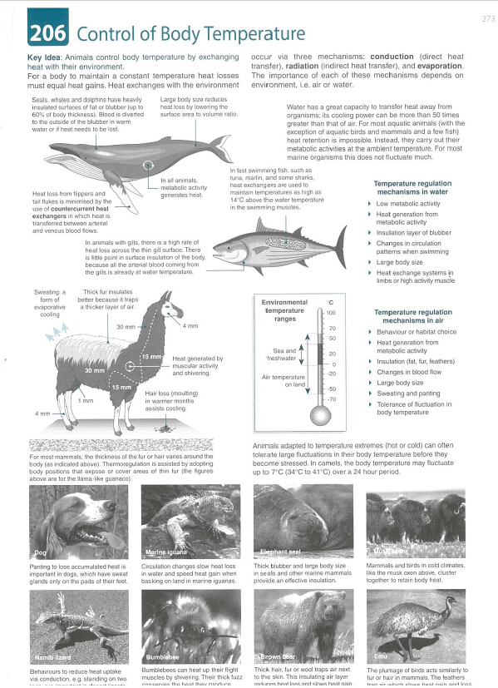
Check for understanding
Biozone 206 – Control of Body Temperature

